Slide 1
Number Guessing Game
Kanu Gaba and Chappy Asel

Slide 2
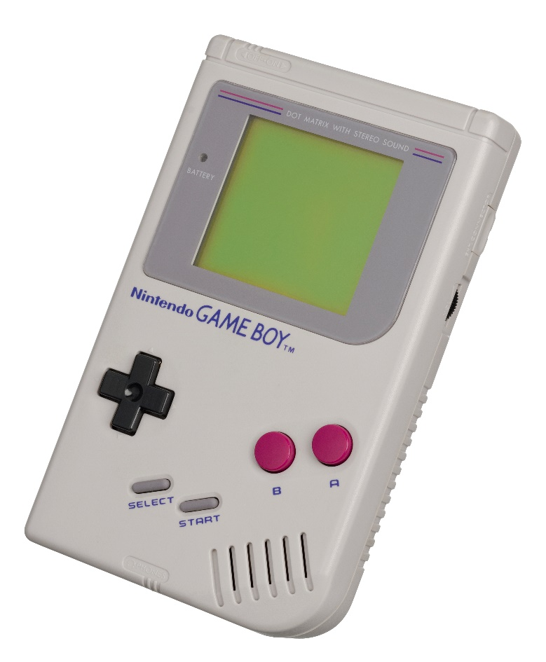
Project Objective/Goal
Create a fun two player game that’s playable on separate Arduinos
Use of Arduino and other tools
Use our new found knowledge

Slide 3
Background
Thought of numerous ideas
Cut the down based on if it’s accomplishable
Both interested in CS
Wanted a code heavy game
Wanted a game that’s easily marketable
Specifics of the Game
Player 1 chooses a number between 0-99
Sends the number to player 2
Player 2 guesses a number, hits enter, indication LEDs accordingly (Green, Yellow, Red), and lives decrease
Indication if won or has no more lives

Slide 4
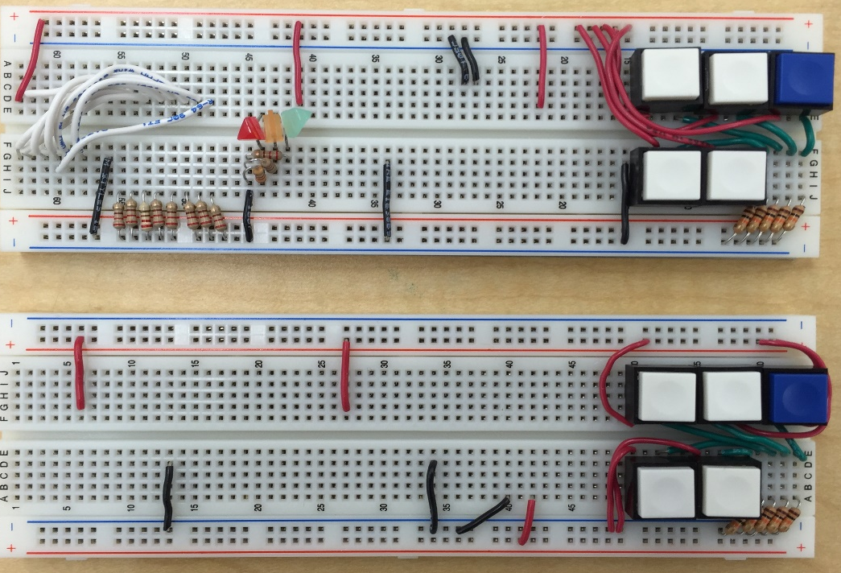
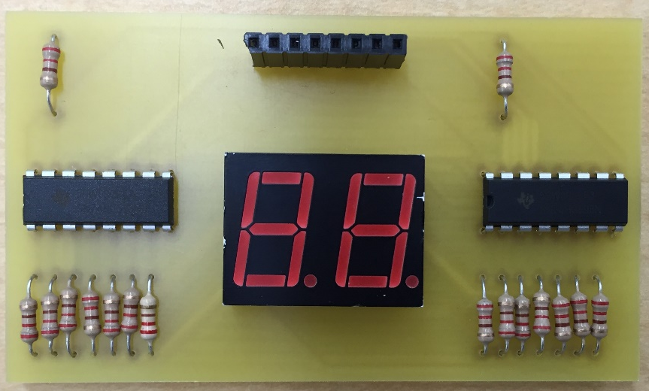
Brainstorming/Design
Breadboard
Limited Space
Display Wiring
PCB Printing
Display only
Complicated wiring afterwards
Entire board (Shield)
Single-sided board
Lite version of Eagle
Double-sided board

Slide 5
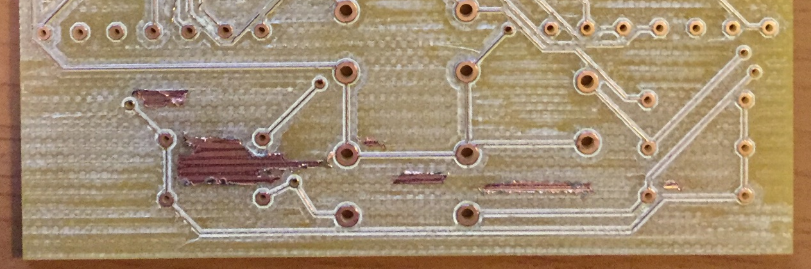

Construction
After the printing
Solder all materials
Code program
Problems:
Finding right materials
Went to electronics lab
Via size issues
Manually change all sizes
Machine complications (torn wires)
Increasing wire width and spacing
Flipped board layers when printing
Reverse solder most materials
Ribbon wires

Slide 6
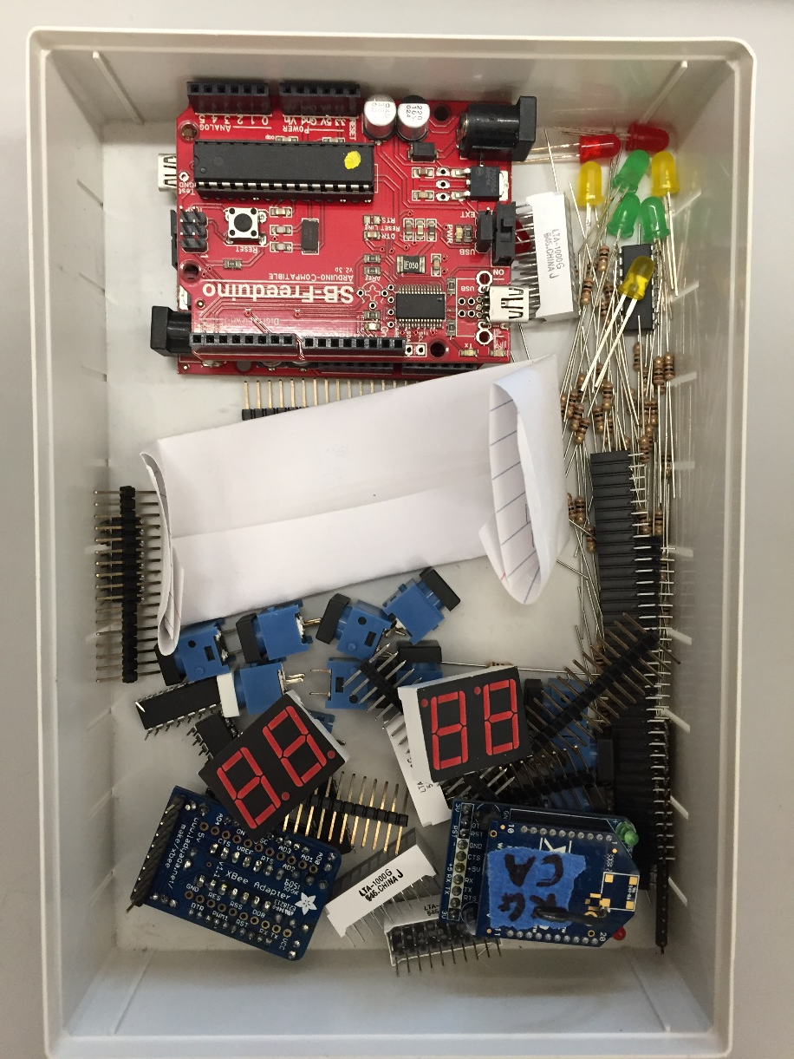
Materials
All materials x2 for two boards
Materials | Amount
Arduino Uno | 1
100 Ohm Resistors | 29
1k Ohm Resistors | 5
74HC595N Shift Registers | 3
LED Bar Graph | 1
2-Digit Seven Segment Display | 1
Buttons | 5
Colored LEDs | 3
10-Pin Female Headers | 1
8-Pin Male Headers | 2
6-Pin Male Headers | 2
Ribbon Wires | 6

Slide 7
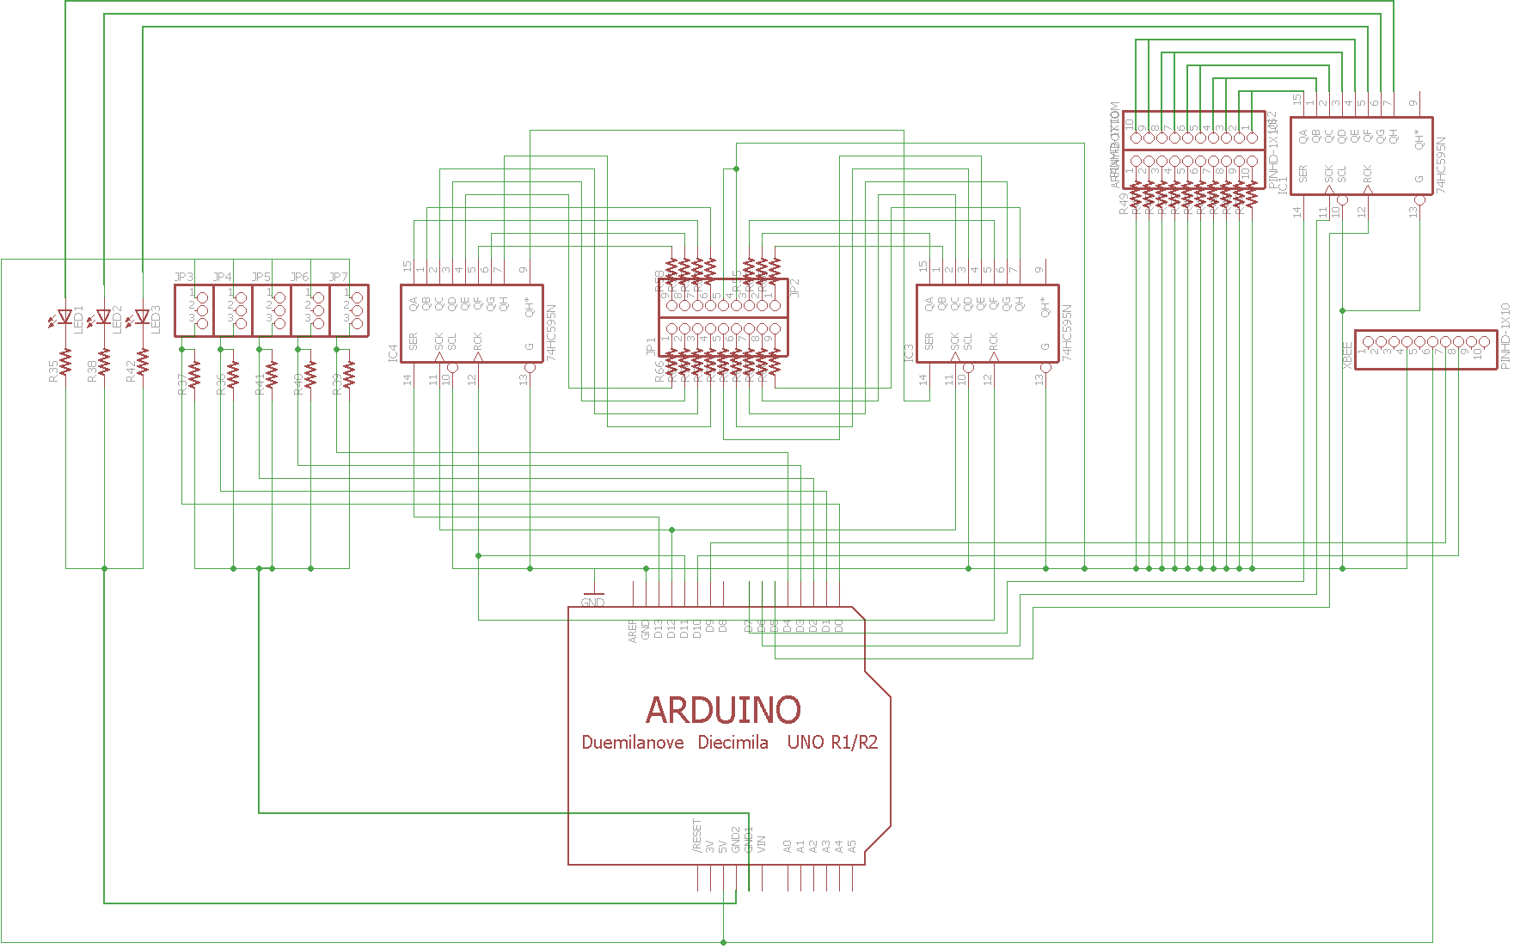
Schematic

Slide 8
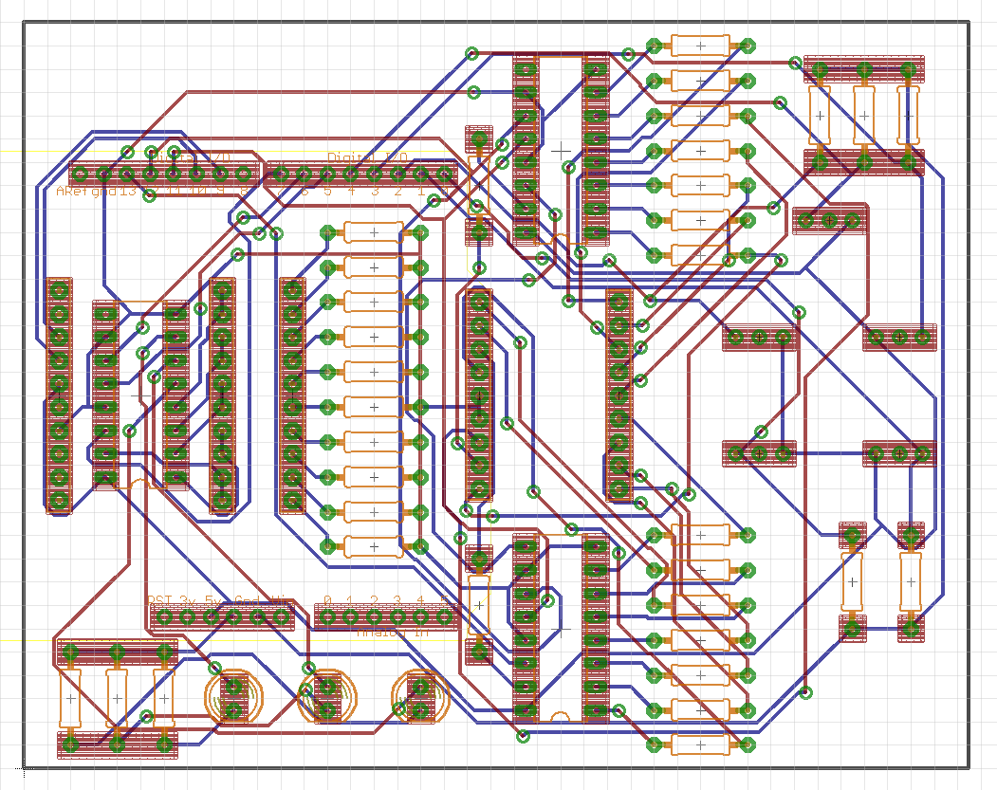
Board Layout

Slide 9
Code
Two players
Player 1 sends the number to be guessed
Next slide
Player 2 guesses the number
Next two slides

Slide 10
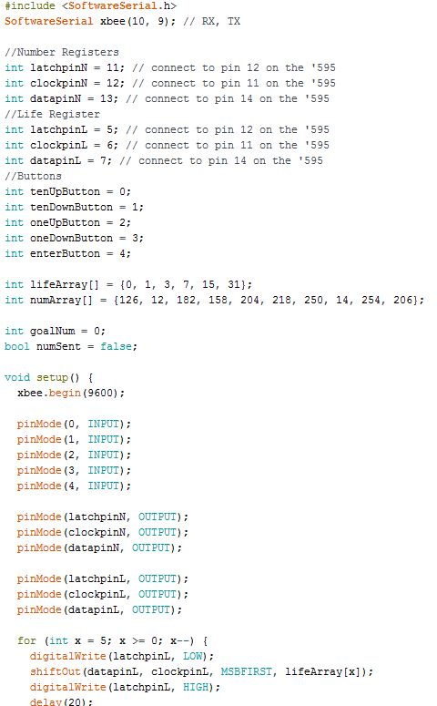
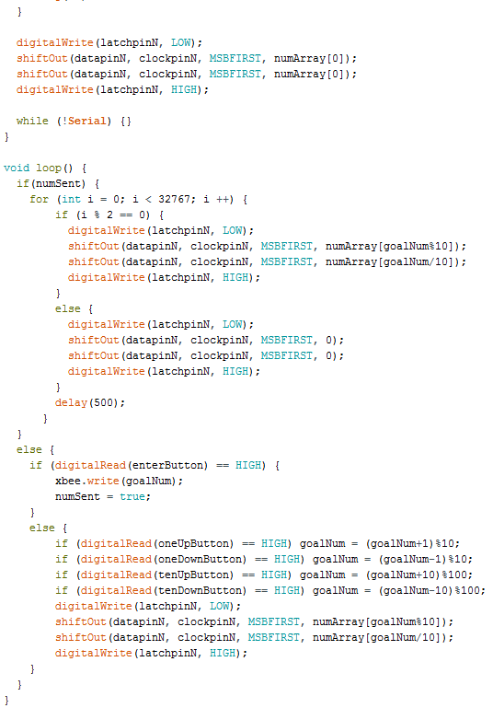
Code
Player 1

Slide 11
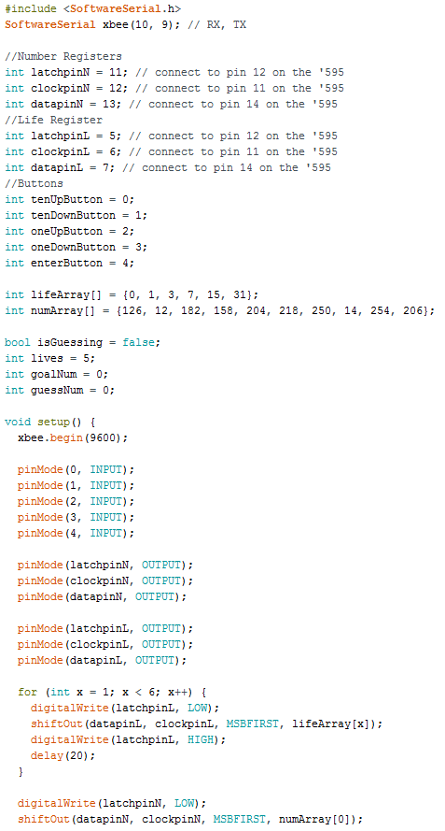
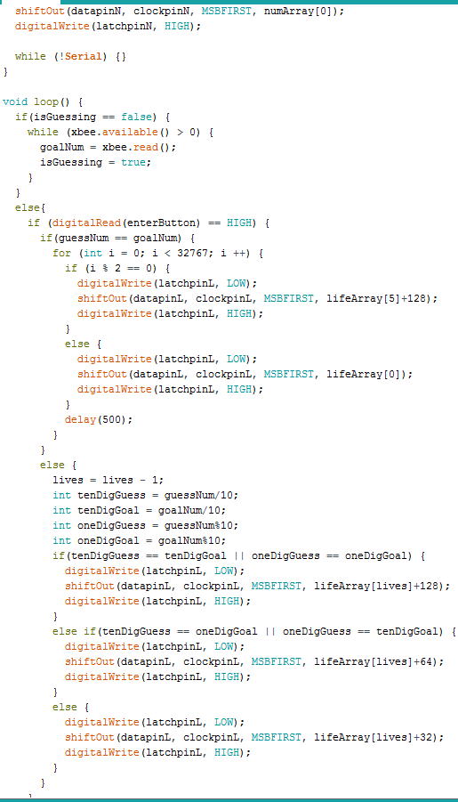
Player 2

Slide 12
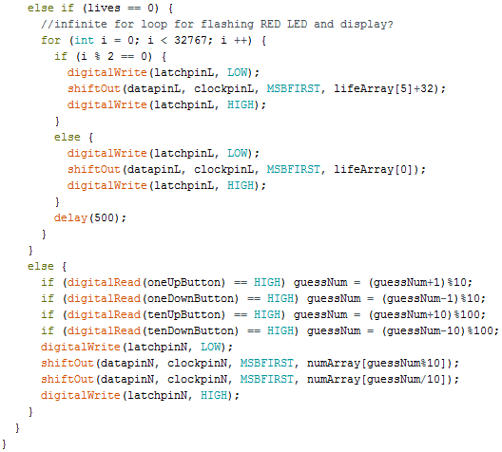
Player 2 Cont.

Slide 13
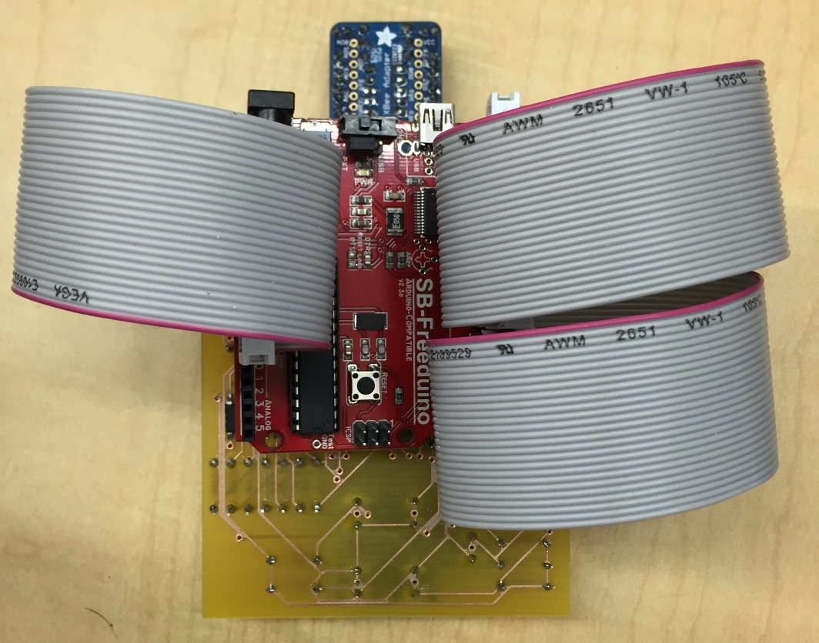
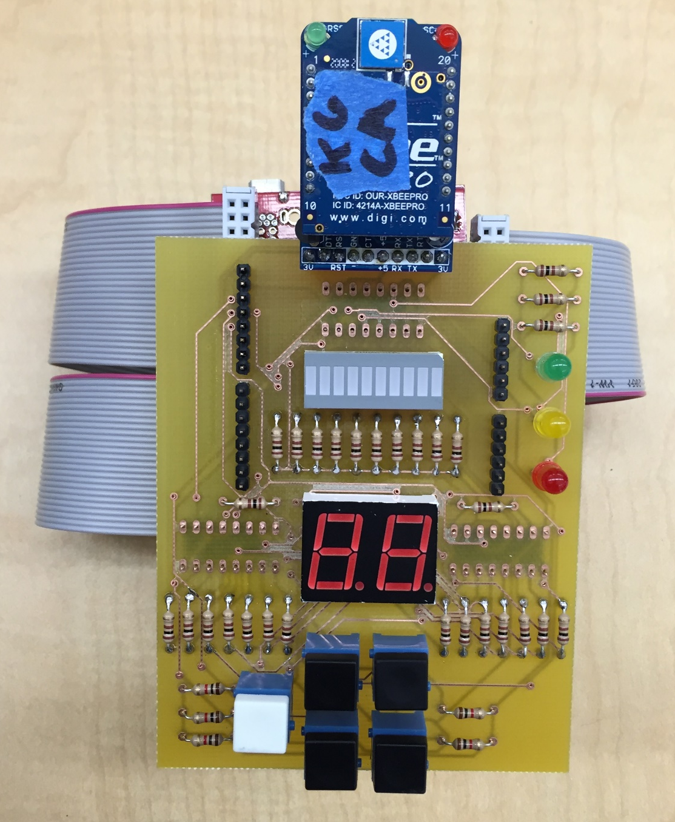
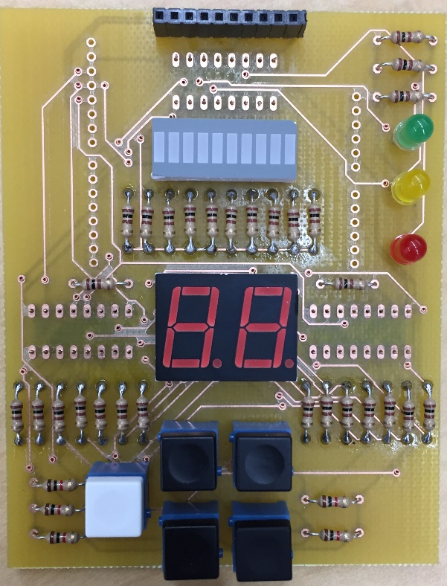
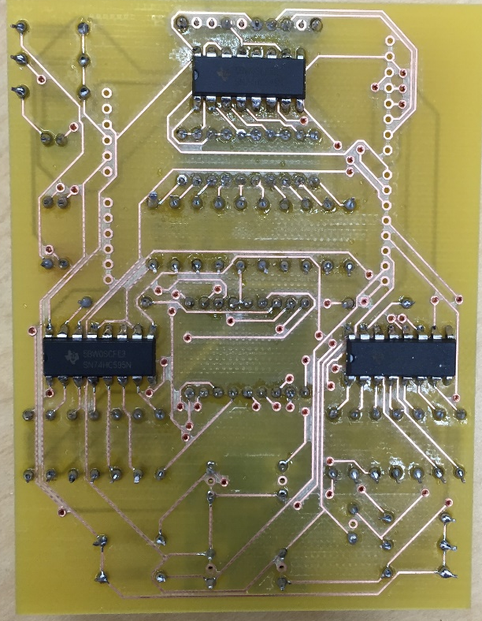

Slide 14
Conclusion
Our LEDs and Xbees working
LEDs very dim
Too much resistance?
Display and lives bar not working
Shift register problem?
Printing layers on opposite sides made soldering difficult
Think about designs first before testing them out one by one
Now that we have more knowledge of the tools, probably could make it work by printing the board correctly

Slide 15
Demo
Demonstration of what should have happened

